Slide 1

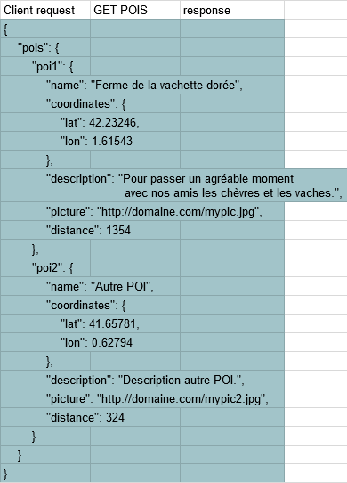
Client
Application Server
DB server
POST to DB Server
{
"coordinates": {
"lat": 42.23245,
"lon": 1.61543
},
"options": {
"nb": 1
}
}
DB Server response
Object | Attributes | Type | Unit
"POI_name1" | coordinates | coordinates object | see coordinates object
 | description | String | -
 | picture | String | URL
 | distance | Float | m
"POI_name2" | ...

